Slide 1
SESSION 1
INTRODUCTION TO AI

Slide 2
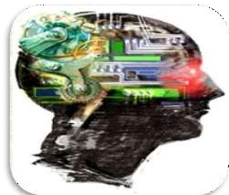
INTRODUCTION
Intelligence : “The capacity to learn and solve problems.”
Artificial Intelligence : Artificial Intelligence (AI) is the simulation of
human intelligence by machines.
The ability to solve problems.
The ability to act rationally.
The ability to act like humans.
The central principles of Al include :
Reasoning, knowledge, planning, learning and communication.
Perception and the ability to move and manipulate objects.
It is the science and engineering of making intelligent machines, especially intelligent computer programs

Slide 3
DEFINITION
Computers with the ability to mimic or duplicate the functions of the human brain.
Artificial Intelligence is the intelligence of machines and the branch of computer science which aims to create it.
"The branch of computer science that is concerned with the automation of intelligent behaviour" (Luger and Stubblefield. 1993).

Slide 4
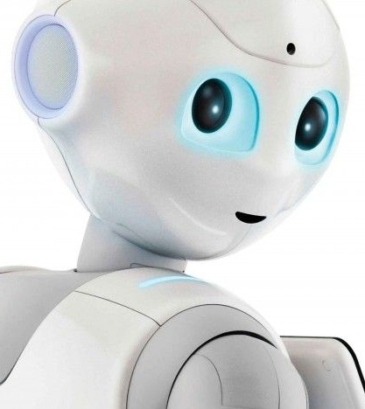
What is Artificial Intelligence?
Artificial Intelligence is the development of computer systems that are able to perform tasks that would require human intelligence.
Examples of these tasks are visual perception, speech recognition,
decision-making, and translation between languages.

Slide 5
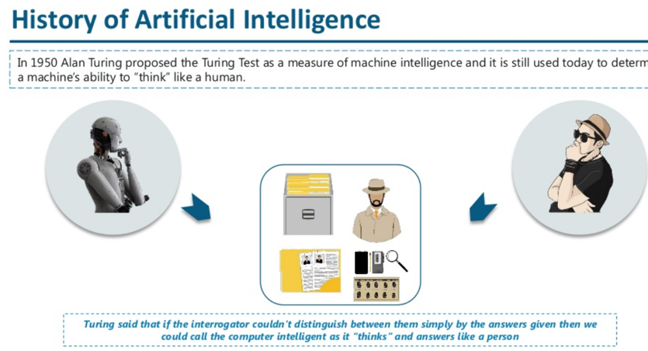

Slide 6

Controversy of Turing Test
Some people disagree with the Turing Test. They claim it does not actually measure a computer's intelligence.
Instead of coming up with a response themselves, they can use the same generic phrases to pass the test.

Slide 7
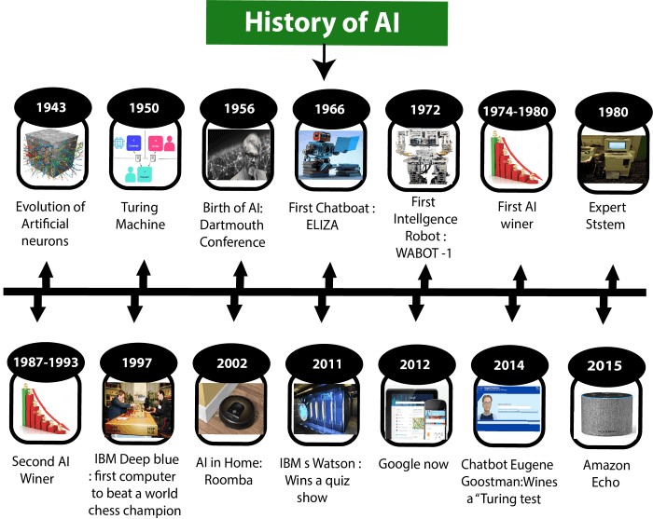

Slide 8
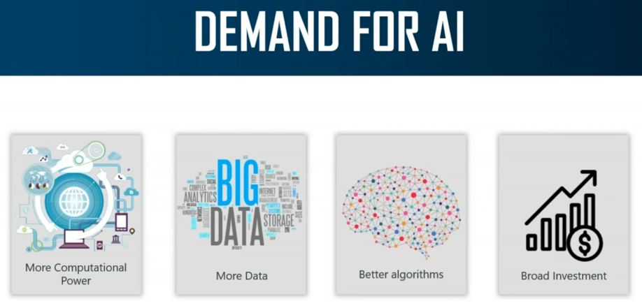

Slide 9
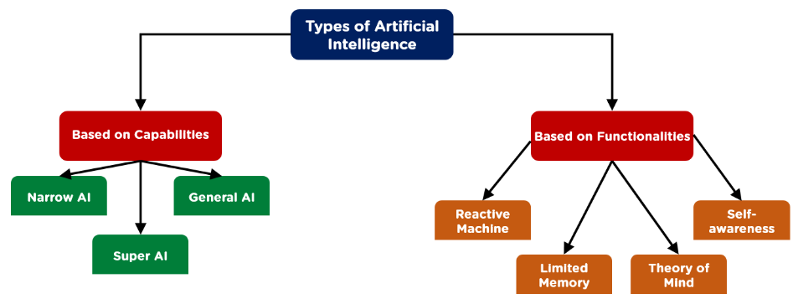
TYPES OF ARTIFICIAL INTELLIGENCE

Slide 10
TYPES OF ARTIFICIAL INTELLIGENCE-TYPE 1
Narrow AI is a type of AI which is able to perform a dedicated task with intelligence. The most common and currently available AI is Narrow AI in the world of Artificial Intelligence.
Narrow AI cannot perform beyond its field or limitations, as it is only trained for one specific task. Hence it is also termed as weak AI. Narrow AI can fail in unpredictable ways if it goes beyond its limits.
Apple Siri a good example of Narrow AI, but it operates with a limited pre-defined range of functions.
IBM's Watson supercomputer also comes under Narrow AI, as it uses an Expert system approach combined with Machine learning and natural language processing.
Some Examples of Narrow AI are playing chess, purchasing suggestions on e-commerce site, self-driving cars, speech recognition, and image recognition.

Slide 11
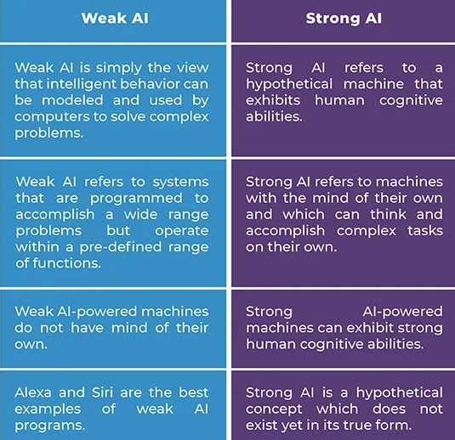
WEAK AI VS STRONG AI

Slide 12
TYPES OF ARTIFICIAL INTELLIGENCE-TYPE 1
2. General AI:
General AI is a type of intelligence which could perform any intellectual task with efficiency like a human.
The idea behind the general AI to make such a system which could be smarter and think like a human by its own.
3. Super AI:
Super AI is a level of Intelligence of Systems at which machines could surpass human intelligence, and can perform any task better than human with cognitive properties. It is an outcome of general AI.
Some key characteristics of strong AI include capability include the ability to think, to reason, solve the puzzle, make judgments, plan, learn, and communicate by its own.
Super AI is still a hypothetical concept of Artificial Intelligence. Development of such systems in real is still world changing task.

Slide 13
TYPES OF ARTIFICIAL INTELLIGENCE-TYPE 2
1. Reactive Machines
Purely reactive machines are the most basic types of Artificial Intelligence.
Such AI systems do not store memories or past experiences for future actions.
These machines only focus on current scenarios and react on it as per possible best action.
IBM's Deep Blue system,Google's AlphaGo is also an example of reactive machines.
2. Limited Memory
Limited memory machines can store past experiences or some data for a short period of time.
These machines can use stored data for a limited time period only.
Self-driving cars are one of the best examples of Limited Memory systems. These cars can store recent speed of nearby cars, the distance of other cars, speed limit, and other information to navigate the road.

Slide 14
TYPES OF ARTIFICIAL INTELLIGENCE-TYPE 2
3. Theory of Mind
Theory of Mind AI should understand the human emotions, people, beliefs, and be able to interact socially like humans.
This type of AI machines are still not developed, but researchers are making lots of efforts and improvement for developing such AI machines.
Eg One real-world example of the theory of mind AI is Kismet, Sophia from Hanson Robotics
4. Self-Awareness
Self-awareness AI is the future of Artificial Intelligence. These machines will be super intelligent, and will have their own consciousness, sentiments, and self-awareness.
These machines will be smarter than human mind.
Self-Awareness AI does not exist in reality still and it is a hypothetical concept.

Slide 15
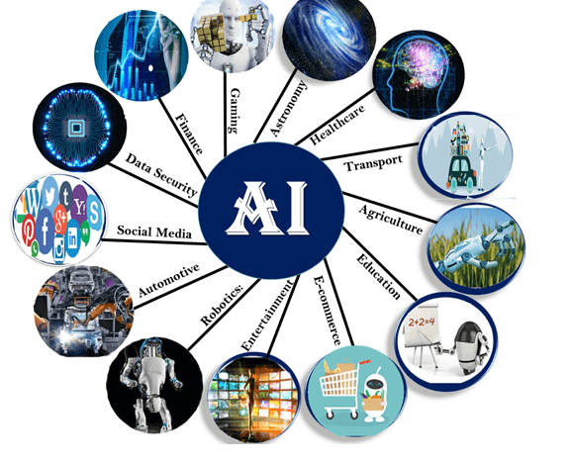
Artificial Intelligence Applications

Slide 16
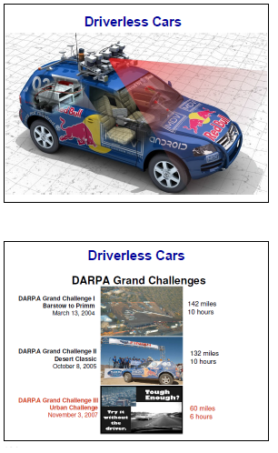
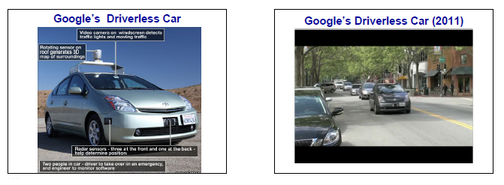
TRANSPORT

Slide 17
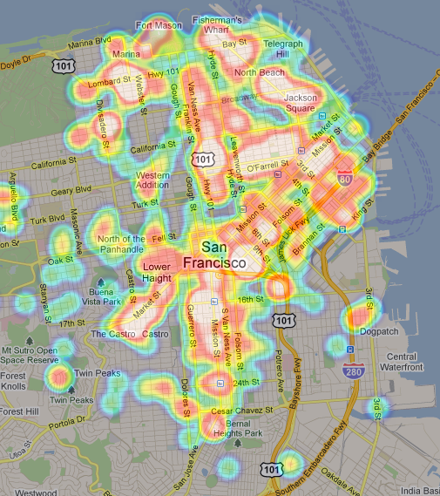
TRANSPORT
Google’s AI-Powered Predictions

Slide 18
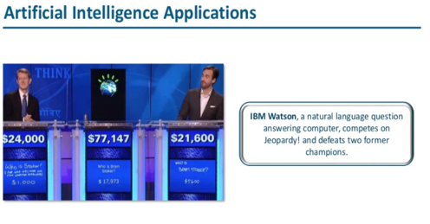
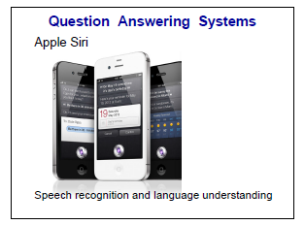
Smart Personal Assistants

Slide 19
Smart Personal Assistants
Amazon Expanded Upon This Model With The Announcement Of Complimentary Hardware And Software Components:
Alexa, An Ai-powered Personal Assistant That Accepts Voice Commands To Create To-do Lists, Order Items Online, Set Reminders, And Answer Questions (Via Internet Searches)
Echo (And Later, Dot) Smart Speakers That Allow You To Integrate Alexa Into Your Living Room And Use Voice Commands To Ask Natural Language Questions, Play Music, Order Pizza, Hail An Uber, And Integrate With Smart Home Devices.
Microsoft Has Followed Suit With Cortana, Its Own AI Assistant That Comes Pre-loaded On Windows Computers And Microsoft Smartphones.

Slide 20
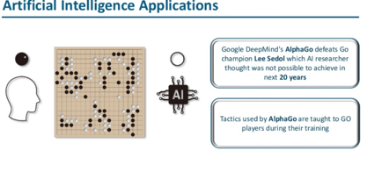
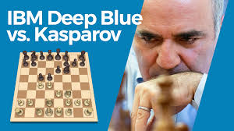
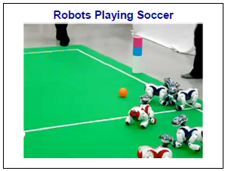
GAMING

Slide 21
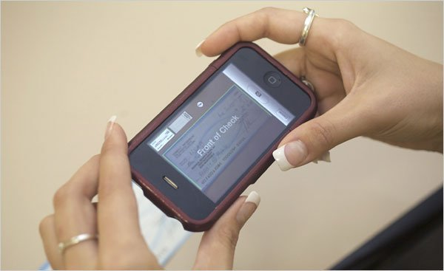
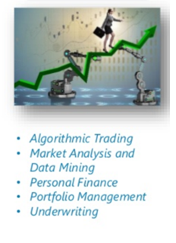
FINANCE
Mobile Check Deposits
Fraud Prevention
Credit Decisions

Slide 22
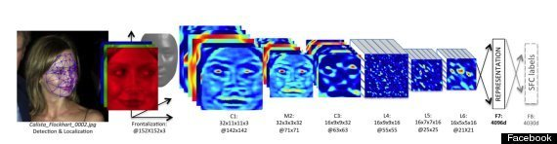
SOCIAL MEDIA
Facebook’s facial recognition
Pinterest: automatically identify objects in images (or “pins”) and then recommend visually similar pins. Other applications of machine learning at Pinterest include spam prevention, search and discovery, ad performance and monetization, and email marketing.
Instagram:to identify the contextual meaning of emoji, which have been steadily replacing slang
snapchat: filters track facial movements, allowing users to add animated effects or digital masks that adjust when their faces moved.

Slide 23
ONLINE SHOPPING
Search
Recommendations
Fraud Protection

Slide 24
Grading and Assessment
Plagiarism Checkers
Many high school and college students are familiar with services like Turnitin, a popular tool used by instructors to analyze students’ writing for plagiarism.
Robo-readers
Essay grading is very labor intensive, which has encouraged researchers and companies to build essay-grading AIs.
The Graduate Record Exam (GRE), the primary test used for graduate school, grades essays using one human reader and one robo-reader called e-Rater.

Slide 25
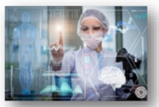
Health Sector
A deep learning model named COVID-19 detection neural network (COVNet), was developed to extract visual features from 4,356 computed tomography (CT) exams from 3,322 patients for the detection of COVID-19.
Early detection and epidemic analysis
Containment
Triage and diagnosis

Slide 26
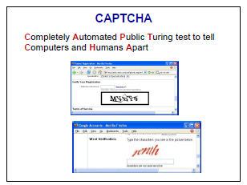
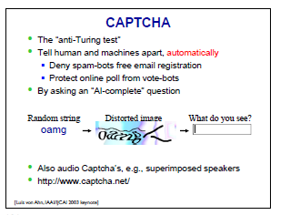
SOME AI PROBLEMS ARE VERY HARD

Slide 27
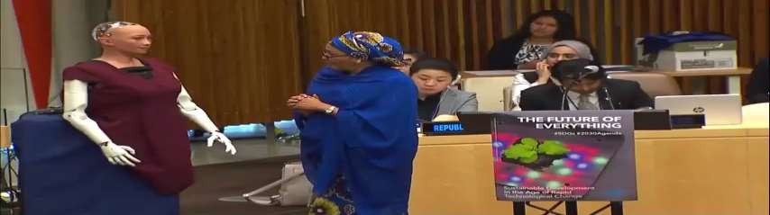
HUMANOID ROBOT
Sophia is a social humanoid robot developed by Hong Kong based company Hanson Robotics.
Sophia was activated on April 19,2015.
She made her first public appearance at South by Southwest Festival in mid-March 2016 in United States.
In October 2017 Sophia became a Saudi Arabian citizen, the first robot to receive citizenship in any country.

Slide 28
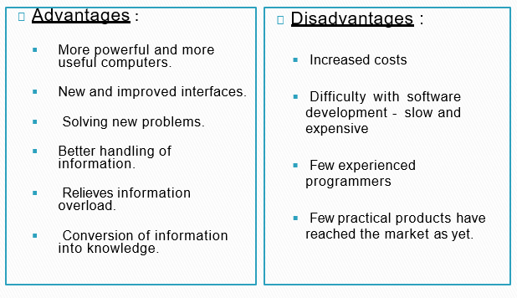
ADVANTAGES N DISADVANTAGES

Slide 29
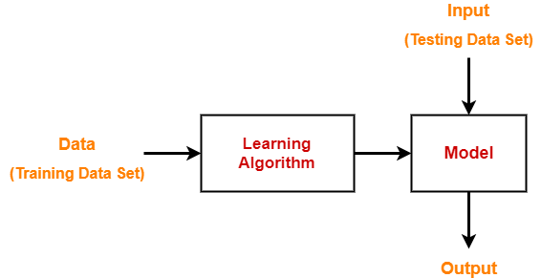
Machine Learning-
Dataset contains a lot of separate pieces of data but can be used to train an algorithm with the goal of finding predictable patterns inside the whole dataset.

Slide 30
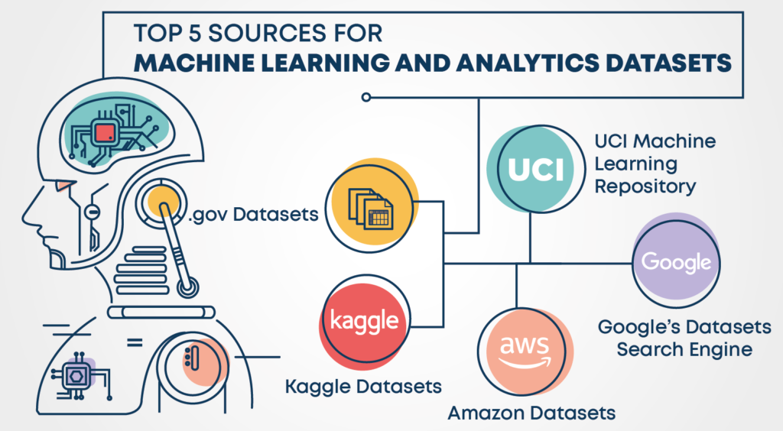
Popular sources for Machine Learning datasets

Slide 31
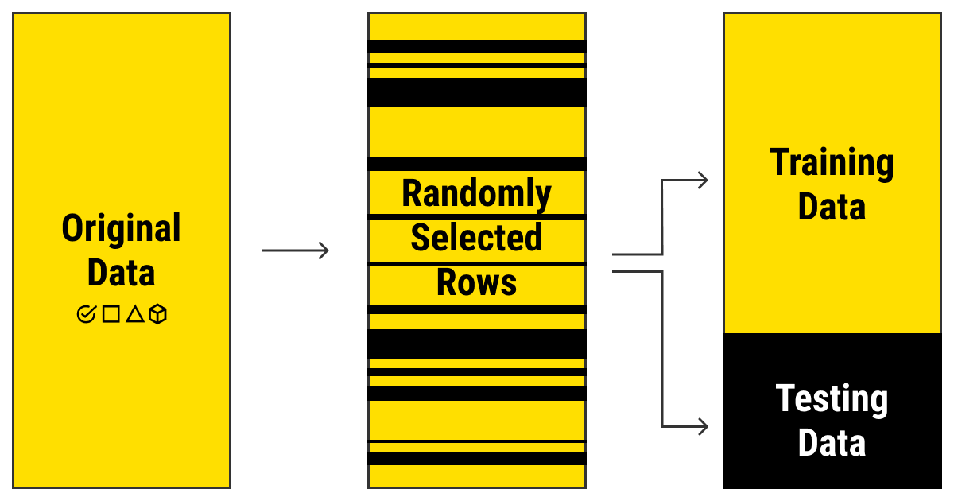

Slide 32
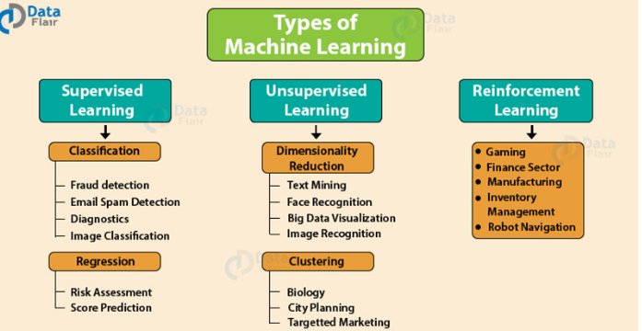

Slide 33
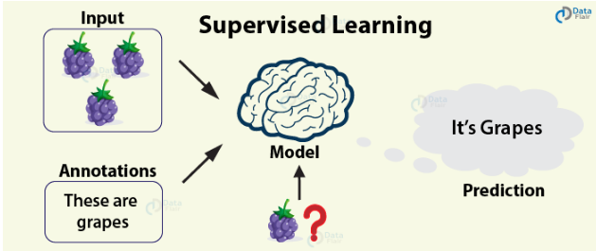
Supervised Learning

Slide 34
Supervised Learning
Supervised Learning is the most popular paradigm for performing machine learning operations.
It is widely used for data where there is a precise mapping between input-output data.
The dataset, in this case, is labeled, meaning that the algorithm identifies the features explicitly and carries out predictions or classification accordingly.
As the training period progresses, the algorithm is able to identify the relationships between the two variables such that we can predict a new outcome.

Slide 35
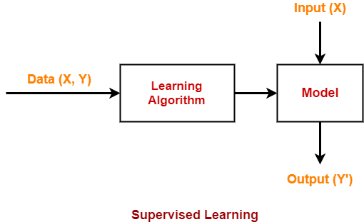
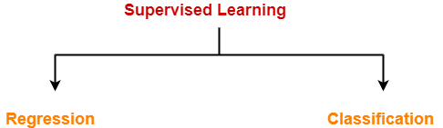

Slide 36
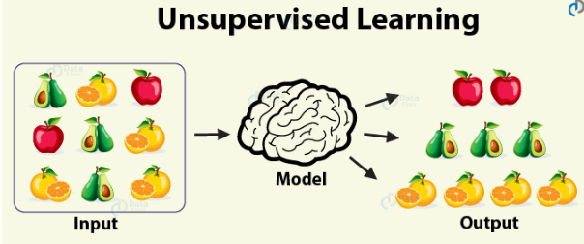
Unsupervised Learning

Slide 37
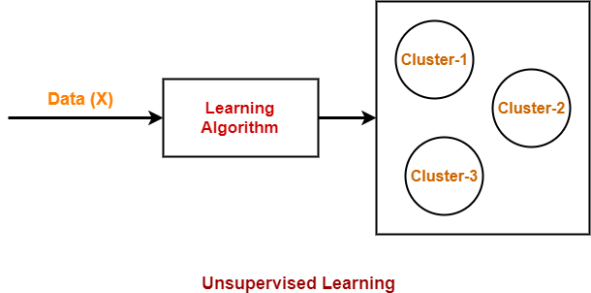

Slide 38
Unsupervised learning algorithm
In the case of unsupervised learning algorithm, the data is not explicitly labeled into different classes, that is, there are no labels.
The model is able to learn from the data by finding implicit patterns.
Unsupervised Learning algorithms identify the data based on their densities, structures, similar segments, and other similar features.
Unsupervised Learning Algorithms are based on Hebbian Learning.
Cluster analysis is one of the most widely used techniques in supervised learning.

Slide 39
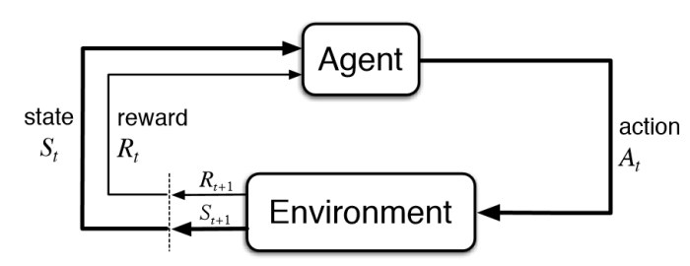
Reinforcement Learning
Reinforcement Learning covers more area of Artificial Intelligence which allows machines to interact with their dynamic environment in order to reach their goals.
With this, machines and software agents are able to evaluate the ideal behavior in a specific context.
With the help of this reward feedback, agents are able to learn the behavior and improve it in the longer run.
This simple feedback reward is known as a reinforcement signal.

Slide 40
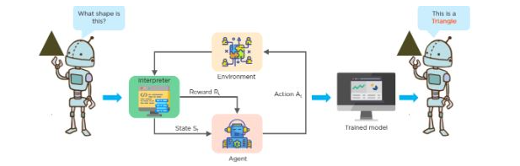

Slide 41
KEY RESEARCH AREAS IN AI
Problem Solving, Planning, And Search --- Generic Problem Solving Architecture Based On Ideas From Cognitive Science (Game Playing, Robotics).
Knowledge Representation – To Store And Manipulate Information (Logical And Probabilistic Representations)
Automated Reasoning / Inference – To Use The Stored Information To Answer Questions And Draw New Conclusions
Machine Learning – Intelligence From Data; To Adapt To New Circumstances And To Detect And Extrapolate Patterns
Natural Language Processing – To Communicate With The Machine
Computer Vision --- Processing Visual Information
Robotics --- Autonomy, Manipulation, Full Integration Of AI Capabilities

